Slide 1

Data Storages & Permissions
Maxim Leykin (maxim.leykin@gmail.com)

Slide 2
Permissions

Slide 3

Android Permissions Model
Beginning Android 6.0 (API level 23), users grant permissions to apps while the app is running, not when they install the app.
System Permissions
Normal permissions do not directly risk the user's privacy. If your app lists a normal permission in its manifest, the system grants the permission automatically.
Dangerous permissions can give the app access to the user's confidential data. If your app lists a normal permission in its manifest, the system grants the permission automatically. If you list a dangerous permission, the user has to explicitly give approval to your app.
If the device is running Android 5.1 or lower, or your app's target SDK is 22 or lower: If you list a dangerous permission in manifest, the user has to grant the permission when they install the app; if they do not grant the permission, the system does not install the app at all.
If the device is running Android 6.0 or higher, and your app's target SDK is 23 or higher: The app has to list the permissions in the manifest, and it must request each dangerous permission it needs while the app is running. The user can grant or deny each permission, and the app can continue to run with limited capabilities even if the user denies a permission request. Users can revoke permissions from any app at any time, even if the app targets a lower API level. You should test your app to verify that it behaves properly when it's missing a needed permission, regardless of what API level your app targets.

Slide 4
Check for Permissions
If the app has the permission, the method returns PackageManager.PERMISSION_GRANTED, and the app can proceed with the operation. If the app does not have the permission, the method returns PERMISSION_DENIED, and the app has to explicitly ask the user for permission.
// Assume thisActivity is the current activity val permissionCheck = ContextCompat.checkSelfPermission(this, Manifest.permission.WRITE_CALENDAR)

Slide 5
Request the permissions you need
if (ContextCompat.checkSelfPermission(thisActivity, Manifest.permission.READ_CONTACTS) != PackageManager.PERMISSION_GRANTED) {
if (ActivityCompat.shouldShowRequestPermissionRationale(thisActivity, Manifest.permission.READ_CONTACTS)) {
// Show an explanation to the user
} else {
// No explanation needed, we can request the permission.
ActivityCompat.requestPermissions(thisActivity, arrayOf(Manifest.permission.READ_CONTACTS), MY_PERMISSIONS_REQUEST_READ_CONTACTS)
}
}

Slide 6
Request the permissions you need
override fun onRequestPermissionsResult(requestCode: Int, permissions: Array<out String>, grantResults: IntArray) {
when (requestCode) {
MY_PERMISSIONS_REQUEST_READ_CONTACTS -> {
// If request is cancelled, the result arrays are empty.
if (grantResults.isNotEmpty() && grantResults[0] == PackageManager.PERMISSION_GRANTED) {
// permission was granted, yay!
} else {
// permission denied, boo! Disable the functionality that depends on this permission.
}
}
// other 'when' branches to check for other permissions this app might request
}
}

Slide 7
Data Storages

Slide 8
Approaches to Store Data
In Android there are following methods to store data:
Shared preferences - store private primitive data in key-value pairs
Files – arbitrary files
Resources of the application
Internal storage - store private data on the device memory
External storage - store public data on the shared external storage.
SQLite databases - store structured data in a private database.
To access data we can use Content Providers.

Slide 9
Shared Preferences

Slide 10
How to Use Shared Preferences?
The SharedPreferences class provides a general framework that allows you to save and retrieve persistent key-value pairs of primitive data types.
You can use SharedPreferences to save any primitive data: > booleans, floats, ints, longs, and strings.
This data will persist across user sessions (even if your application is killed).
To get a SharedPreferences object for your application, use one of two methods:
getSharedPreferences() - Use this if you need multiple preferences files identified by name, which you specify with the first parameter.
getPreferences() - Use this if you need only one preferences file for your Activity. Because this will be the only preferences file for your Activity, you don't supply a name.
To write values:
Call edit() to get a SharedPreferences.Editor.
Add values with methods such as putBoolean() and putString().
Commit the new values with commit()
To read values:
use SharedPreferences methods such as getBoolean() and getString()

Slide 11
How to Write to Shared Preferences?
protected fun savePreferences(context: Context) {
// Create or retrieve the shared preference object.
val MYPREFS = "mySharedPreferences"
val mode = Context.MODE_PRIVATE
val mySharedPreferences: SharedPreferences = context.getSharedPreferences(MYPREFS, mode)
// Retrieve an editor to modify the shared preferences.
val editor: SharedPreferences.Editor = mySharedPreferences.edit()
// Store new primitive types in the shared preferences object.
editor.putBoolean("isTrue", true)
editor.putFloat("lastFloat", 1f)
editor.putInt("wholeNumber", 2)
editor.putLong("aNumber", 3L)
editor.putString("textEntryValue", "Not Empty")
// Commit the changes.
editor.apply()
}

Slide 12
How to Read from Shared Preferences?
fun loadPreferences(context: Context) {
// Get the stored preferences
val MYPREFS = "mySharedPreferences"
val mode = Context.MODE_PRIVATE
val mySharedPreferences: SharedPreferences = context.getSharedPreferences(MYPREFS, mode)
// Retrieve the saved values.
val isTrue: Boolean = mySharedPreferences.getBoolean("isTrue", false)
val lastFloat: Float = mySharedPreferences.getFloat("lastFloat", 0f)
val wholeNumber: Int = mySharedPreferences.getInt("wholeNumber", 1)
val aNumber: Long = mySharedPreferences.getLong("aNumber", 0)
val stringPreference: String? = mySharedPreferences.getString("textEntryValue", "")
}

Slide 13
Activity Specific Shared Preferences
protected fun saveActivityPreferences() {
// Create or retrieve the activity preferences object.
val activityPreferences: SharedPreferences = getPreferences(Activity.MODE_PRIVATE)
// Retrieve an editor to modify the shared preferences.
val editor: SharedPreferences.Editor = activityPreferences.edit()
// Retrieve the View
val myTextView: TextView = findViewById(R.id.myTextView)
// Store new primitive types in the shared preferences object.
editor.putString("currentTextValue", myTextView.text.toString())
// Commit changes.
editor.apply()
}

Slide 14
Files in Application

Slide 15
Files in Resources
Static files are stored in /res/raw folder
Since raw is a subfolder of Resources (res), Android will automatically generate an ID for any file located inside it. This ID is then stored an the R class that will act as a reference to a file, meaning it can be easily accessed from other Android classes and methods and even in Android XML files. Using the automatically generated ID is the fastest way to have access to a file in Android.
Accessible from code via method Resources getResources()
Readable as InputStream:
InputStream in=getResources().openRawResource(R.raw.words);
Not writable!
Sample: RawResources

Slide 16
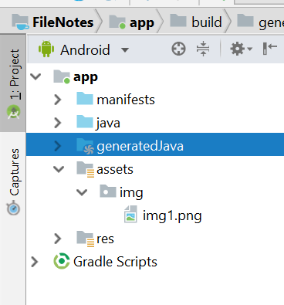
Files in Assets
The /assets folder is an “appendix” directory. The R class does not generate IDs for the files placed there, so its less compatible with some Android classes and methods. Also, it’s much slower to access a file inside it, since you will need to get a handle to it based on a String. You can navigate this directory in the same way as a typical file system using URIs and read files as a stream of bytes using the AssetManager . For example, this is a good location for file hierarchy, textures and game data.
val assetManager: AssetManager = assets
val inputStream = assetManager.open("img/img1.png")
val bitmap = BitmapFactory.decodeStream(inputStream)
imageView.setImageBitmap(bitmap)

Slide 17
Files in Internal/External Storages

Slide 18
Internal vs External storages
Internal Storage | External Storage
It's always available. Files saved here are accessible by only your app. When the user uninstalls your app, the system removes all your app's files from internal storage. Internal storage is best when you want to be sure that neither the user nor other apps can access your files. | It's not always available, because the user can mount the external storage as USB storage and in some cases remove it from the device. It's world-readable, so files saved here may be read outside of your control. When the user uninstalls your app, the system removes your app's files from here only if you save them in the directory from getExternalFilesDir(). External storage is the best place for files that don't require access restrictions and for files that you want to share with other apps or allow the user to access with a computer.
Internal storage:
External storage:

Slide 19
Files in Internal Storage
You can save files directly on the device's internal storage.
By default, files saved to the internal storage are private to your application and other applications cannot access them
When the user uninstalls your application, these files are removed

Slide 20
Files in Internal Storage
To create and write a private file to the internal storage:
Call openFileOutput() with the name of the file and the operating mode. This returns a FileOutputStream object
Write to the file with write()
Close the stream with close()
To read a file from internal storage:
Call openFileInput() and pass it the name of the file to read. This returns a FileInputStream.
Read bytes from the file with read()
Then close the stream with close()
val FILENAME = "hello_file”
val string = "hello world!”
val fos = openFileOutput(FILENAME, Context.MODE_PRIVATE)
fos.write(string.toByteArray())
fos.close()
val FILENAME = "hello_file“
val fis: FileInputStream = openFileInput(FILENAME)
val n: Int = fis.read()
fis.close()

Slide 21
Useful Methods
getFilesDir()
Gets the absolute path to the filesystem directory where your internal files are saved.
getDir()
Creates (or opens an existing) directory within your internal storage space.
deleteFile()
Deletes a file saved on the internal storage.
fileList()
Returns an array of files currently saved by your application.
getCacheDir()
Returns a File representing the cache directory on the file system that's uniquely associated with your app. This directory is meant for temporary files, and it should be cleaned up regularly. The system may delete files there if it runs low on disk space, so make sure you check for the existence of your cache files before reading them.

Slide 22
Using External Storage
You can save two different types of files in external storage:
Public files: Files that should be freely available to other apps and to the user. When the user uninstalls your app, these files should remain available to the user. For example, photos captured by your app or other downloaded files should be saved as public files.
Private files: Files that rightfully belong to your app and will be deleted when the user uninstalls your app. Although these files are technically accessible by the user and other apps because they are on the external storage, they don't provide value to the user outside of your app.

Slide 23
Requesting Read/Write Permissions
To write to the public external storage, you must request the WRITE_EXTERNAL_STORAGE permission in your manifest file and in runtime when your app attempts to perform actual write operation.
<manifest ...>
<uses-permission android:name="android.permission.WRITE_EXTERNAL_STORAGE" />
...
</manifest>
If your app only needs to read the external storage (but not write to it), then you need to declare (and request in runtime) the READ_EXTERNAL_STORAGE permission
<manifest ...>
<uses-permission android:name="android.permission.READ_EXTERNAL_STORAGE" />
...
</manifest>

Slide 24
Checking Media Availability
Before you do any work with the external storage, you should always call getExternalStorageState() to check the state of the media
Mounted
Missing
Read-only
Some other state
var externalStorageAvailable = false
var externalStorageWriteable = false
val state = Environment.getExternalStorageState()
when (state) {
Environment.MEDIA_MOUNTED -> {
// We can read and write the media
externalStorageAvailable = true
externalStorageWriteable = true
}
Environment.MEDIA_MOUNTED_READ_ONLY -> {
// We can only read the media
externalStorageAvailable = true
externalStorageWriteable = false
}
else -> {
// Something else is wrong. It may be one of many other states,
// but all we need to know is we can neither read nor write
externalStorageAvailable = false
externalStorageWriteable = false
}
}

Slide 25
Saving to a private directory
Use getExternalFilesDir() to open a File that represents the external storage directory where
you should save your files
This method takes a type parameter that specifies the type of subdirectory you want, such as DIRECTORY_MUSIC and DIRECTORY_RINGTONES
This method will create the appropriate directory if necessary.
By specifying the type of directory, you ensure that the Android's media scanner will properly categorize your files in the system (for example, ringtones are identified as ringtones and not music).
If the user uninstalls your application, this directory and all its contents will be deleted.
fun getPrivateAlbumStorageDir(context: Context, albumName: String): File {
// Get the directory for the app's private pictures directory.
val file = File(context.getExternalFilesDir(Environment.DIRECTORY_PICTURES), albumName)
if (!file.mkdirs()) {
Log.e(LOG_TAG, "Directory not created")
}
return file
}

Slide 26
Saving to a public directory
If you want to save files that are not specific to your application and that should not be deleted when your application is uninstalled, save them to one of the public directories on the external storage.
These directories lay at the root of the external storage, such as Music/, Pictures/, Ringtones/, and others
Use getExternalStoragePublicDirectory(), passing it the type of public directory you want, such as DIRECTORY_MUSIC, DIRECTORY_PICTURES, DIRECTORY_RINGTONES, or others
This method will create the appropriate directory if necessary
Sample: FIleNotes
fun getPublicAlbumStorageDir(albumName: String): File {
// Get the directory for the user's public pictures directory.
val file = File(Environment.getExternalStoragePublicDirectory(
Environment.DIRECTORY_PICTURES), albumName)
if (!file.mkdirs()) {
Log.e(LOG_TAG, "Directory not created")
}
return file
}

Slide 27
SQLite and Room

Slide 28
SQLite
SQLite is a software library that implements a selfcontained, serverless, zero-configuration, transactional SQL database engine.
Android provides full support for SQLite databases.
Database is private to the application that creates it: i.e. any databases you create will be accessible to any class in the application, but not outside the application.
All databases are stored in /data/data/ <package_name>/databases folder on your device
It is possible to operate with SQLite databases directly using SQLite API defined in android.database.sqlite package. But nowadays it is recommended to use Room Persistence Library for DB operations.
Major problems with direct usage of SQLite usage are:
There is no compile-time verification of raw SQL queries. For example, if you write a SQL query with a wrong column name that does not exist in real database then it will give exception during runtime and you can not capture this issue during compile time.
As your schema changes, you need to update the affected SQL queries manually. This process can be time-consuming and error-prone.
You need to use lots of boilerplate code to convert between SQL queries and Java data objects (POJO).

Slide 29
Room Persistence Library
Room is an ORM, Object Relational Mapping library. In other words, Room will map our database objects to Java objects. Room provides an abstraction layer over SQLite to allow fluent database access while harnessing the full power of SQLite. It provides:
Compile-time verification of SQL queries. each @Query and @Entity is checked at the compile time, that preserves your app from crash issues at runtime and not only it checks the only syntax, but also missing tables.
Easy integration with other Architecture components (like LiveData or RxJava)
Less amount of boilerplate code to be written

Slide 30
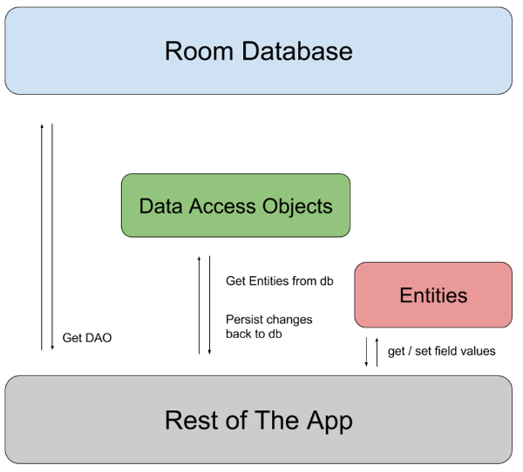
Components of Room DB
There are three major components in Room:
The database class that holds the database and serves as the main access point for the underlying connection to your app's persisted data.
Data entities that represent tables in your app's database.
Data access objects (DAOs) that provide methods that your app can use to query, update, insert, and delete data in the database.
The database class provides your app with instances of the DAOs associated with that database. In turn, the app can use the DAOs to retrieve data from the database as instances of the associated data entity objects. The app can also use the defined data entities to update rows from the corresponding tables, or to create new rows for insertion. Figure 1 illustrates the relationship between the different components of Room.

Slide 31
Data Entity – simple definition
Each entity corresponds to a table in the associated Room database, and each instance of an entity represents a row of data in the corresponding table. That means you can use Room entities to define your database schema without writing any SQL code.
The following code defines a User data entity. Each instance of User represents a row in a user table in the app's database.
@Entity
data class User(
@PrimaryKey
val id: Int,
val firstName: String,
val lastName: String
)
Each Room entity must define a primary key that uniquely identifies each row in the corresponding database table. The most straightforward way of doing this is to annotate a single column with @PrimaryKey.
If you need instances of an entity to be uniquely identified by a combination of multiple columns, you can define a composite primary key by listing those columns in the primaryKeys property of @Entity:
@Entity(primaryKeys = {"firstName", "lastName"})

Slide 32
Data Entity – name aliases
@Entity(tableName = "users")
data class User(
@PrimaryKey
val id: Int,
@ColumnInfo(name = "first_name")
val firstName: String,
@ColumnInfo(name = "last_name")
val lastName: String
)
By default, Room uses the class name as the database table name. If you want the table to have a different name, set the tableName property of the @Entity annotation. Similarly, Room uses the field names as column names in the database by default. If you want a column to have a different name, add the @ColumnInfo annotation to the field and set the name property. The following example demonstrates custom names for tables and columns:

Slide 33
Data Entity – ignore fields
@Entity
data class User(
@PrimaryKey
val id: Int,
val firstName: String,
val lastName: String
) {
@Ignore
var picture: Bitmap? = null
}
By default, Room creates a column for each field that's defined in the entity. If an entity has fields that you don't want to persist, you can annotate them using @Ignore

Slide 34
Data Access Object (DAO) – basic case
When you use the Room persistence library to store your app's data, you interact with the stored data by defining data access objects, or DAOs. Each DAO includes methods that offer abstract access to your app's database. At compile time, Room automatically generates implementations of the DAOs that you define.
You can define each DAO as either an interface or an abstract class. For basic use cases, you should usually use an interface. In either case, you must always annotate your DAOs with @Dao. DAOs don't have properties, but they do define one or more methods for interacting with the data in your app's database.
@Dao
interface UserDao {
@Insert
fun insertAll(vararg users: User)
@Delete
fun delete(user: User)
@Query("SELECT * FROM user")
fun getAll(): List<User>
}

Slide 35
Data Access Object (DAO) – method types
DAO methods
Convenience methods that let you insert, update, and delete rows in your database without writing any SQL code. Room provides convenience annotations for defining methods that perform simple inserts, updates, and deletes without requiring you to write a SQL statement.
Query methods that let you write your own SQL query to interact with the database. The @Query annotation allows you to write SQL statements and expose them as DAO methods. Use these query methods to query data from your app's database, or when you need to perform more complex inserts, updates, and deletes. Room validates SQL queries at compile time.

Slide 36
Data Access Object (DAO) – Insert methods
The @Insert annotation allows you to define methods that insert their parameters into the appropriate table in the database. Each parameter for an @Insert method must be either an instance of a Room data entity class annotated with @Entity or a collection of data entity class instances. When an @Insert method is called, Room inserts each passed entity instance into the corresponding database table. If the @Insert method receives a single parameter, it can return a long value, which is the new rowId for the inserted item. If the parameter is an array or a collection, then the method should return an array or a collection of long values instead, with each value as the rowId for one of the inserted items.
@Dao
interface UserDao {
@Insert(onConflict = OnConflictStrategy.REPLACE)
fun insertUser(user: User): Long
@Insert
fun insertBothUsers(user1: User, user2: User): List<Long>
@Insert
fun insertUsersAndFriends(user: User, friends: List<User>): List<Long>
}

Slide 37
Data Access Object (DAO) – Update methods
The @Update annotation allows you to define methods that update specific rows in a database table. Similarly to @Insert methods, @Update methods accept data entity instances as parameters. Room uses the primary key to match passed entity instances to rows in the database. If there is no row with the same primary key, Room makes no changes.
An @Update method can optionally return an int value indicating the number of rows that were updated successfully.
@Dao
interface UserDao {
@Update
fun updateUsers(vararg users: User)
}

Slide 38
Data Access Object (DAO) – Delete methods
The @Delete annotation allows you to define methods that delete specific rows from a database table. Similarly to @Insert methods, @Delete methods accept data entity instances as parameters. Room uses the primary key to match passed entity instances to rows in the database. If there is no row with the same primary key, Room makes no changes.
A @Delete method can optionally return an int value indicating the number of rows that were deleted successfully.
@Dao
interface UserDao {
@Delete
fun deleteUsers(vararg users: User)
}

Slide 39
Data Access Object (DAO) – Simple Queries
@Query("SELECT * FROM user")
fun loadAllUsers(): Array<User>
Simplest Query – returns all records from the table
data class NamePair(
@ColumnInfo(name = "first_name")
val firstName: String?,
@ColumnInfo(name = "last_name")
val lastName: String
)
@Query("SELECT first_name, last_name FROM user")
fun loadFullName(): List<NamePair>
Room allows you to return a simple object from any of your queries as long as you can map the set of result columns onto the returned object. Room understands that the query returns values for the first_name and last_name columns and that these values can be mapped onto the fields in the NamPair class. If the query returns a column that doesn't map onto a field in the returned object, Room displays a warning.

Slide 40
Data Access Object (DAO) – Parametrized Queries
Most of the time, your DAO methods need to accept parameters so that they can perform filtering operations. Room supports using method parameters as bind parameters in your queries.
@Query("SELECT * FROM user WHERE age > :minAge")
fun loadAllUsersOlderThan(minAge: Int): Array<User>
@Query("SELECT * FROM user WHERE age BETWEEN :minAge AND :maxAge")
fun loadAllUsersBetweenAges(minAge: Int, maxAge: Int): Array<User>
@Query("SELECT * FROM user WHERE first_name LIKE :search " +
"OR last_name LIKE :search")
fun findUserWithName(search: String): List<User>
@Query("SELECT * FROM user WHERE region IN (:regions)")
fun loadUsersFromRegions(regions: List<String>): List<User>

Slide 41
Data Access Object (DAO) – Query Multiple Tables
Some of your queries might require access to multiple tables to calculate the result. You can use JOIN clauses in your SQL queries to reference more than one table.
@Query("
SELECT * FROM book
INNER JOIN loan ON loan.book_id = book.id
INNER JOIN user ON user.id = loan.user_id
WHERE user.name LIKE :userName
")
fun findBooksBorrowedByNameSync(userName: String): List<Book>

Slide 42
Database
To create a database we need to define an abstract class that extends RoomDatabase.
The class must be annotated with a @Database annotation that includes an entities array that lists all of the data entities associated with the database.
The class must be an abstract class that extends RoomDatabase.
For each DAO class that is associated with the database, the database class must define an abstract method that has zero arguments and returns an instance of the DAO class.
@Database(entities = [User::class, Loan::class, Book::class], version = 1)
abstract class AppDatabase : RoomDatabase() {
abstract fun userDao(): UserDao
abstract fun loanDao(): LoanDao
abstract fun bookDao(): BookDao
}

Slide 43
Room - Usage
val db = Room.databaseBuilder(
applicationContext,
AppDatabase::class.java,
"database-name"
).build()
val userDao = db.userDao()
val users: List<User> = userDao.getAll()

Slide 44
Room – Add to the Project
dependencies {
def room_version = "2.6.1"
implementation "androidx.room:room-runtime:$room_version"
annotationProcessor "androidx.room:room-compiler:$room_version"
}

Slide 45
Content Providers

Slide 46
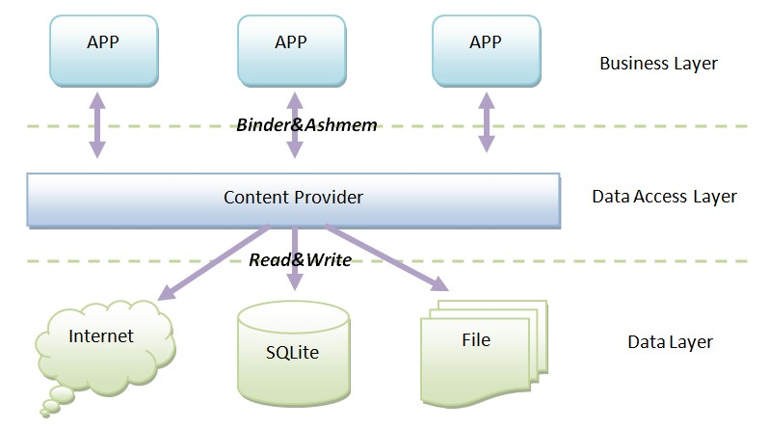
Content Providers
Content providers can help an application manage access to data stored by itself, stored by other apps, and provide a way to share data with other apps. They encapsulate the data, and provide mechanisms for defining data security. Content providers are the standard interface that connects data in one process with code running in another process.
Generic interface for data
Permission control and accessing using URI model
Native databases available as Content Providers
Publishing your own data source, other apps can incorporate your database

Slide 47
Content Resolver
Application context has Content Resolver which you can use to access data:
ContentResolver cr = getContentResolver();
• For accessing other databases, you need a URI
• URI is arbitrary String, which is defined in manifest file
// Query
Cursor c = getContentResolver().query(URI, ..., ... ,...);
// Insert
getContentResolver().insert(URI, newValues);
// Delete
getContentResolver().delete(URIofTheRow, ...);

Slide 48
URIs
Content URIs must be unique between providers.
• Use your package name
• General form
content://com.<company>.provider.<app>/<data>
• Example for querying all items
content://fi.pohjolainen_jussi.provider.myapp/items
• Example for querying single item
content://fi.pohjolainen_jussi.provider.myapp/items/5

Slide 49
Get Data via Content Resolver
Data query via ContentResolver is performed by method query().
public final Cursor query (Uri uri, String[ ] projection, String selection, String[ ] selectionArgs, String sortOrder)
Arguments:
uri – content URI
projection – columns we want to get
selection – where clause with ? as parameter placeholders
selectionArgs – args for where clause
sortOrder – ordering and grouping
// Return all rows
Cursor allRows = getContentResolver().query(MyProvider.CONTENT_URI,
null, null, null, null);
// Return all columns for rows where column 3 equals
//a set value and the rows are ordered by column 5.
String where = KEY_COL3 + “=” + requiredValue;
String order = KEY_COL5;
Cursor someRows = getContentResolver().query(MyProvider.CONTENT_URI,
null, where, null, order);

Slide 50
Insert Data via Content Resolver
Option #1
// Create a new row of values to insert.
ContentValues newValues = new ContentValues();
// Assign values for each row.
newValues.put(COLUMN_NAME, newValue);
…
getContentResolver().insert(MyProvider.CONTENT_URI,
newValues);
Option #2
// Create a new row of values to insert.
ContentValues[] valueArray = new ContentValues[5];
// TODO: Create an array of new rows
int count = getContentResolver().bulkInsert(MyProvider.CONTENT_URI,
valueArray);

Slide 51
Delete and Update Data via Content Resolver
// Remove a specific row.
getContentResolver().delete(myRowUri, null, null);
// Remove the first five rows.
String where = “_id < 5”;
getContentResolver().delete(MyProvider.CONTENT_URI, where, null);
// Create a new row of values to insert.
ContentValues newValues = new ContentValues();
// Create a replacement map, specifying which columns you want to
// update, and what values to assign to each of them.
newValues.put(COLUMN_NAME, newValue);
// Apply to the first 5 rows.
String where = “_id < 5”;
getContentResolver().update(MyProvider.CONTENT_URI, newValues, where, null);

Slide 52
Work with Files via Content Provider
Files are retrieved via URI
try {
// Open an output stream using the new row’s URI.
OutputStream outStream = getContentResolver().openOutputStream(uri);
// Compress your bitmap and save it into your provider.
sourceBitmap.compress(Bitmap.CompressFormat.JPEG, 50, outStream);
}
catch (FileNotFoundException e) { }

Slide 53
Platform Native Content Providers
Browser – access to bookmarks, browser history, web searches.
Calendar – access to calendar and events
CallLog – access to call history
Contacts – access to contacts
MediaStore – access to media
Settings – access to settings
Attention! You need to ask for permissions in order to work with native providers. E.g. for contacts:
<uses-permission android:name="android.permission.READ_CONTACTS" />

Slide 54
Platform Native Content Providers
Uri allCalls = Uri.parse("content://call_log/calls");
Cursor c = managedQuery(allCalls, null, null, null, null);
while (c.moveToNext()) {
String num = c.getString(c.getColumnIndex(CallLog.Calls.NUMBER));// for number
String name = c.getString(c.getColumnIndex(CallLog.Calls.CACHED_NAME));// for name
String duration = c.getString(c.getColumnIndex(CallLog.Calls.DURATION));// for duration
int type = Integer.parseInt(c.getString(c.getColumnIndex(CallLog.Calls.TYPE)));// for call type, Incoming or out going.
Toast.makeText(getApplicationContext(), num + name + duration + type, Toast.LENGTH_SHORT).show();
}
Sample: CallLogSample

Slide 55
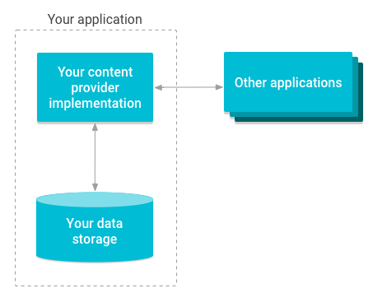
Create Custom Content Provider
This involves number of simple steps to create your own content provider.
First of all you need to create a Content Provider class that extends the ContentProvider base class.
Second, you need to define your content provider URI address which will be used to access the content.
Next you will need to create your own database to keep the content. Usually, Android uses SQLite database and framework needs to override onCreate() method which will use SQLite Open Helper method to create or open the provider's database. When your application is launched, the onCreate() handler of each of its Content Providers is called on the main application thread.
Next you will have to implement Content Provider queries to perform different database specific operations:
query() This method receives a request from a client. The result is returned as a Cursor object.
insert()This method inserts a new record into the content provider.
delete() This method deletes an existing record from the content provider.
update() This method updates an existing record from the content provider.
getType() This method returns the MIME type of the data at the given URI.
Finally register your Content Provider in your manifest file using <provider> tag.

Slide 56
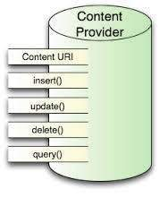
Custom Content Provider - methods
public class MyProvider extends ContentProvider {
public boolean onCreate() { }
public String getType(Uri url) { }
public Cursor query(Uri url, String[] projection, String selection,
String[] selectionArgs, String sort) { }
public Uri insert(Uri _url, ContentValues _initialValues) { }
public int delete(Uri url, String where, String[] whereArgs) { }
public int update(Uri url, ContentValues values, String where, String[] wArgs) { }
}

Slide 57
Custom Content Provider – static members
public class MyProvider extends ContentProvider {
private static final String myURI = “content://com.paad.provider.myapp/items”;
public static final Uri CONTENT_URI = Uri.parse(myURI);
public boolean onCreate() {
// TODO: Construct the underlying database.
return true;
}
// Create the constants used to differentiate between the different URI requests.
private static final int ALLROWS = 1;
private static final int SINGLE_ROW = 2;
private static final UriMatcher uriMatcher;
static {
uriMatcher = new UriMatcher(UriMatcher.NO_MATCH);
uriMatcher.addURI(“com.paad.provider.myApp”, “items”, ALLROWS);
uriMatcher.addURI(“com.paad.provider.myApp”, “items/#”, SINGLE_ROW);
}
}

Slide 58
Custom Content Provider – query()
@Override
public Cursor query(Uri uri, String[] projection, String selection, String[] selectionArgs, String sort) {
// If this is a row query, limit the result set to the passed in row.
switch (uriMatcher.match(uri)) {
case SINGLE_ROW :
// TODO: Modify selection based on row id, where:
// rowNumber = uri.getPathSegments().get(1));
}
return null;
}

Slide 59
Custom Content Provider – insert()
@Override
public Uri insert(Uri _uri, ContentValues _initialValues) {
long rowID = [ ... Add a new item ... ]
// Return a URI to the newly added item.
if (rowID > 0) {
return ContentUris.withAppendedId(CONTENT_URI, rowID);
}
throw new SQLException(“Failed to add new item into “ + _uri);
}

Slide 60
Custom Content Provider – delete()
@Override
public int delete(Uri uri, String where, String[] whereArgs) {
switch (uriMatcher.match(uri)) {
case ALLROWS:
case SINGLE_ROW:
default: throw new IllegalArgumentException(“Unsupported URI:” + uri);
}
}

Slide 61
Custom Content Provider – getType()
@Override
public String getType(Uri _uri) {
switch (uriMatcher.match(_uri)) {
case ALLROWS: return “vnd.paad.cursor.dir/myprovidercontent”;
case SINGLE_ROW: return “vnd.paad.cursor.item/myprovidercontent”;
default: throw new IllegalArgumentException(“Unsupported URI: “ + _uri);
}
}

Slide 62
Custom Content Provider – register
You need to register your provider in AndroidManifest:
<provider android:name=”MyProvider” android:authorities=”com.paad.provider.myapp”/>
Sample: CProvider

